Slide 1
Goal
Design and develop a tool that forecasts how popular a YouTube video will be. An YouTuber will use this feature to plan the ropic of their next or first video.
Understanding the Goal
Why is it important and how can it benefit the user?
Making a right choice can create income/revenue to the youtuber.
It can help them to improve quality or the content in their video.
Making right choices can get them more views and subscribers.
Can help them get fame and also help them to make a career of it.
Problem we are trying solve
User is uncertain on how a the video gets popular or successful.
User want to know to what kind of content is needed based on the location and audience
User is unaware of the reasons why a youtube consumer exits or drops off from the video.
User don’t know the characteristics of a successful video.
Value for the user
Easy to use
Accurate information.
Success to the user

Slide 2
Understanding the Users
Different categories of the user.
Age: Any
Gender: any
Experience: new comer to experience youtuber
Location: Worldwide.
When and where do the user use the product?
It is used by the user before starting the video to chose the right video.
They can try to find it any time, it can happen at home or while travelling.

Slide 3
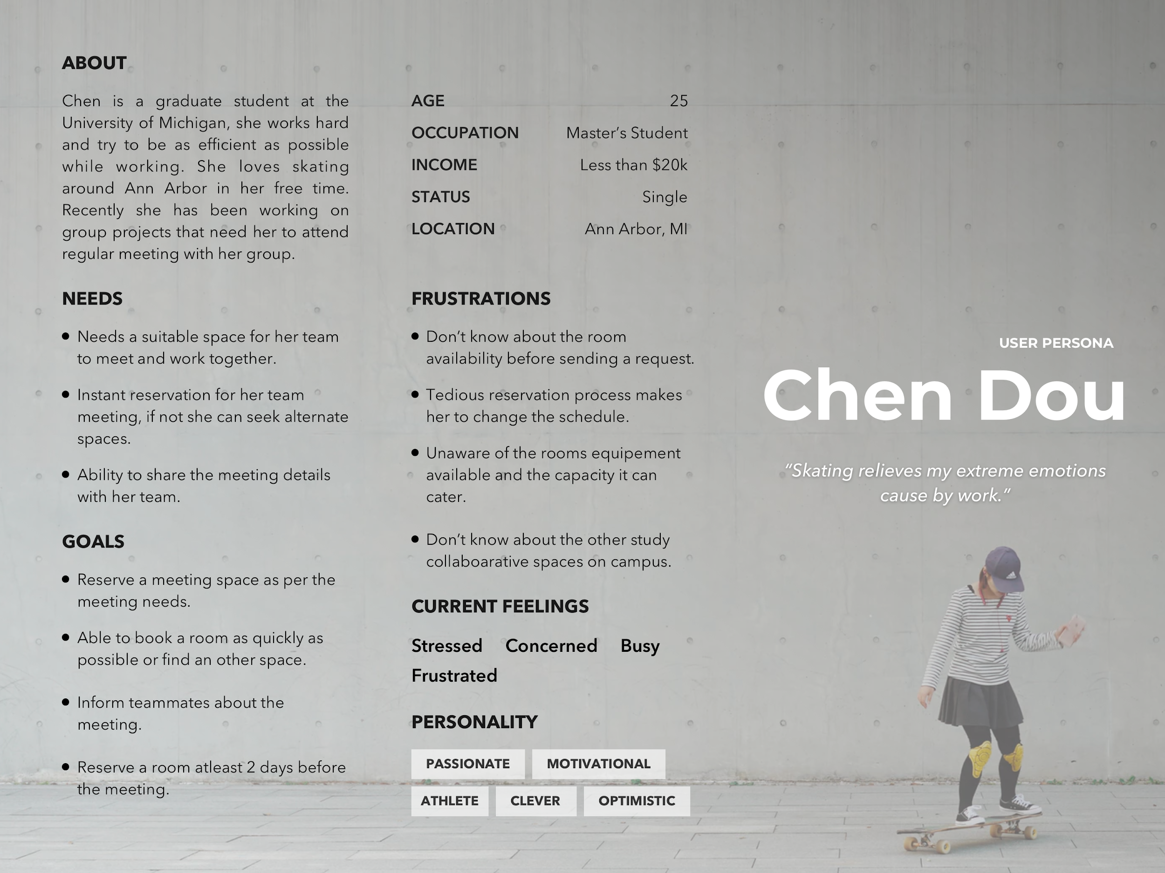
Persona

Slide 4
When and Where: User Stories
As a new youtuber I want to find how many views i can get based on my video choice, so that I can create a successful video.
As a new youtuber I want to find the most viewed/ successful topic, so that I can start my youtube channel.
As a new youtuber I want to find the most viewed content, so that I can choose the category/genre of my video.
As a new youtuber I want to find the most viewed/ succesful content duration, so that I can define my video duration.

Slide 5
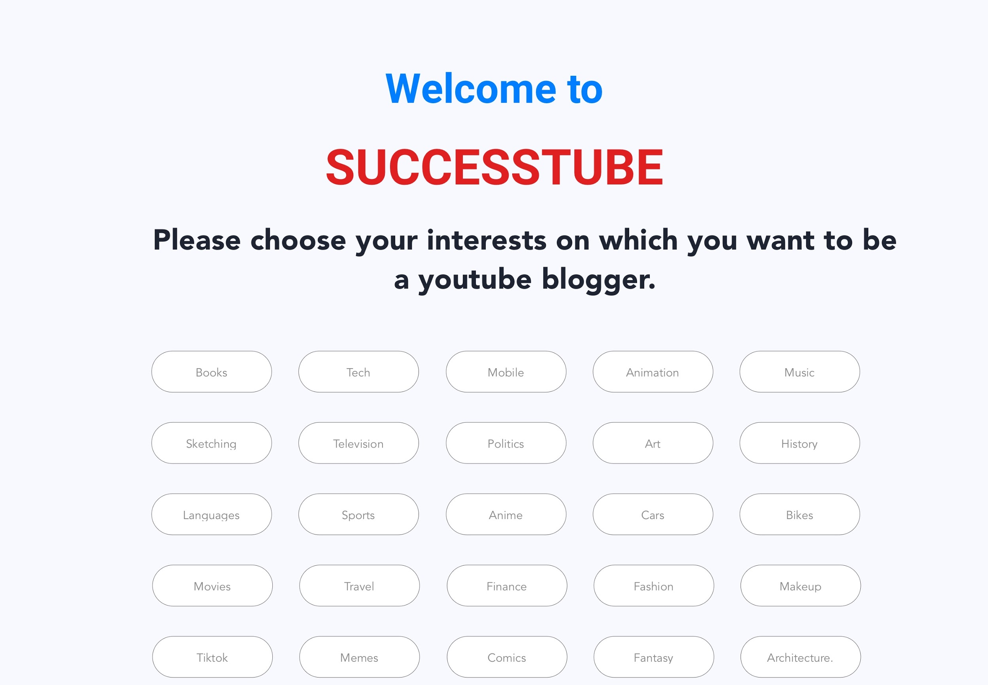
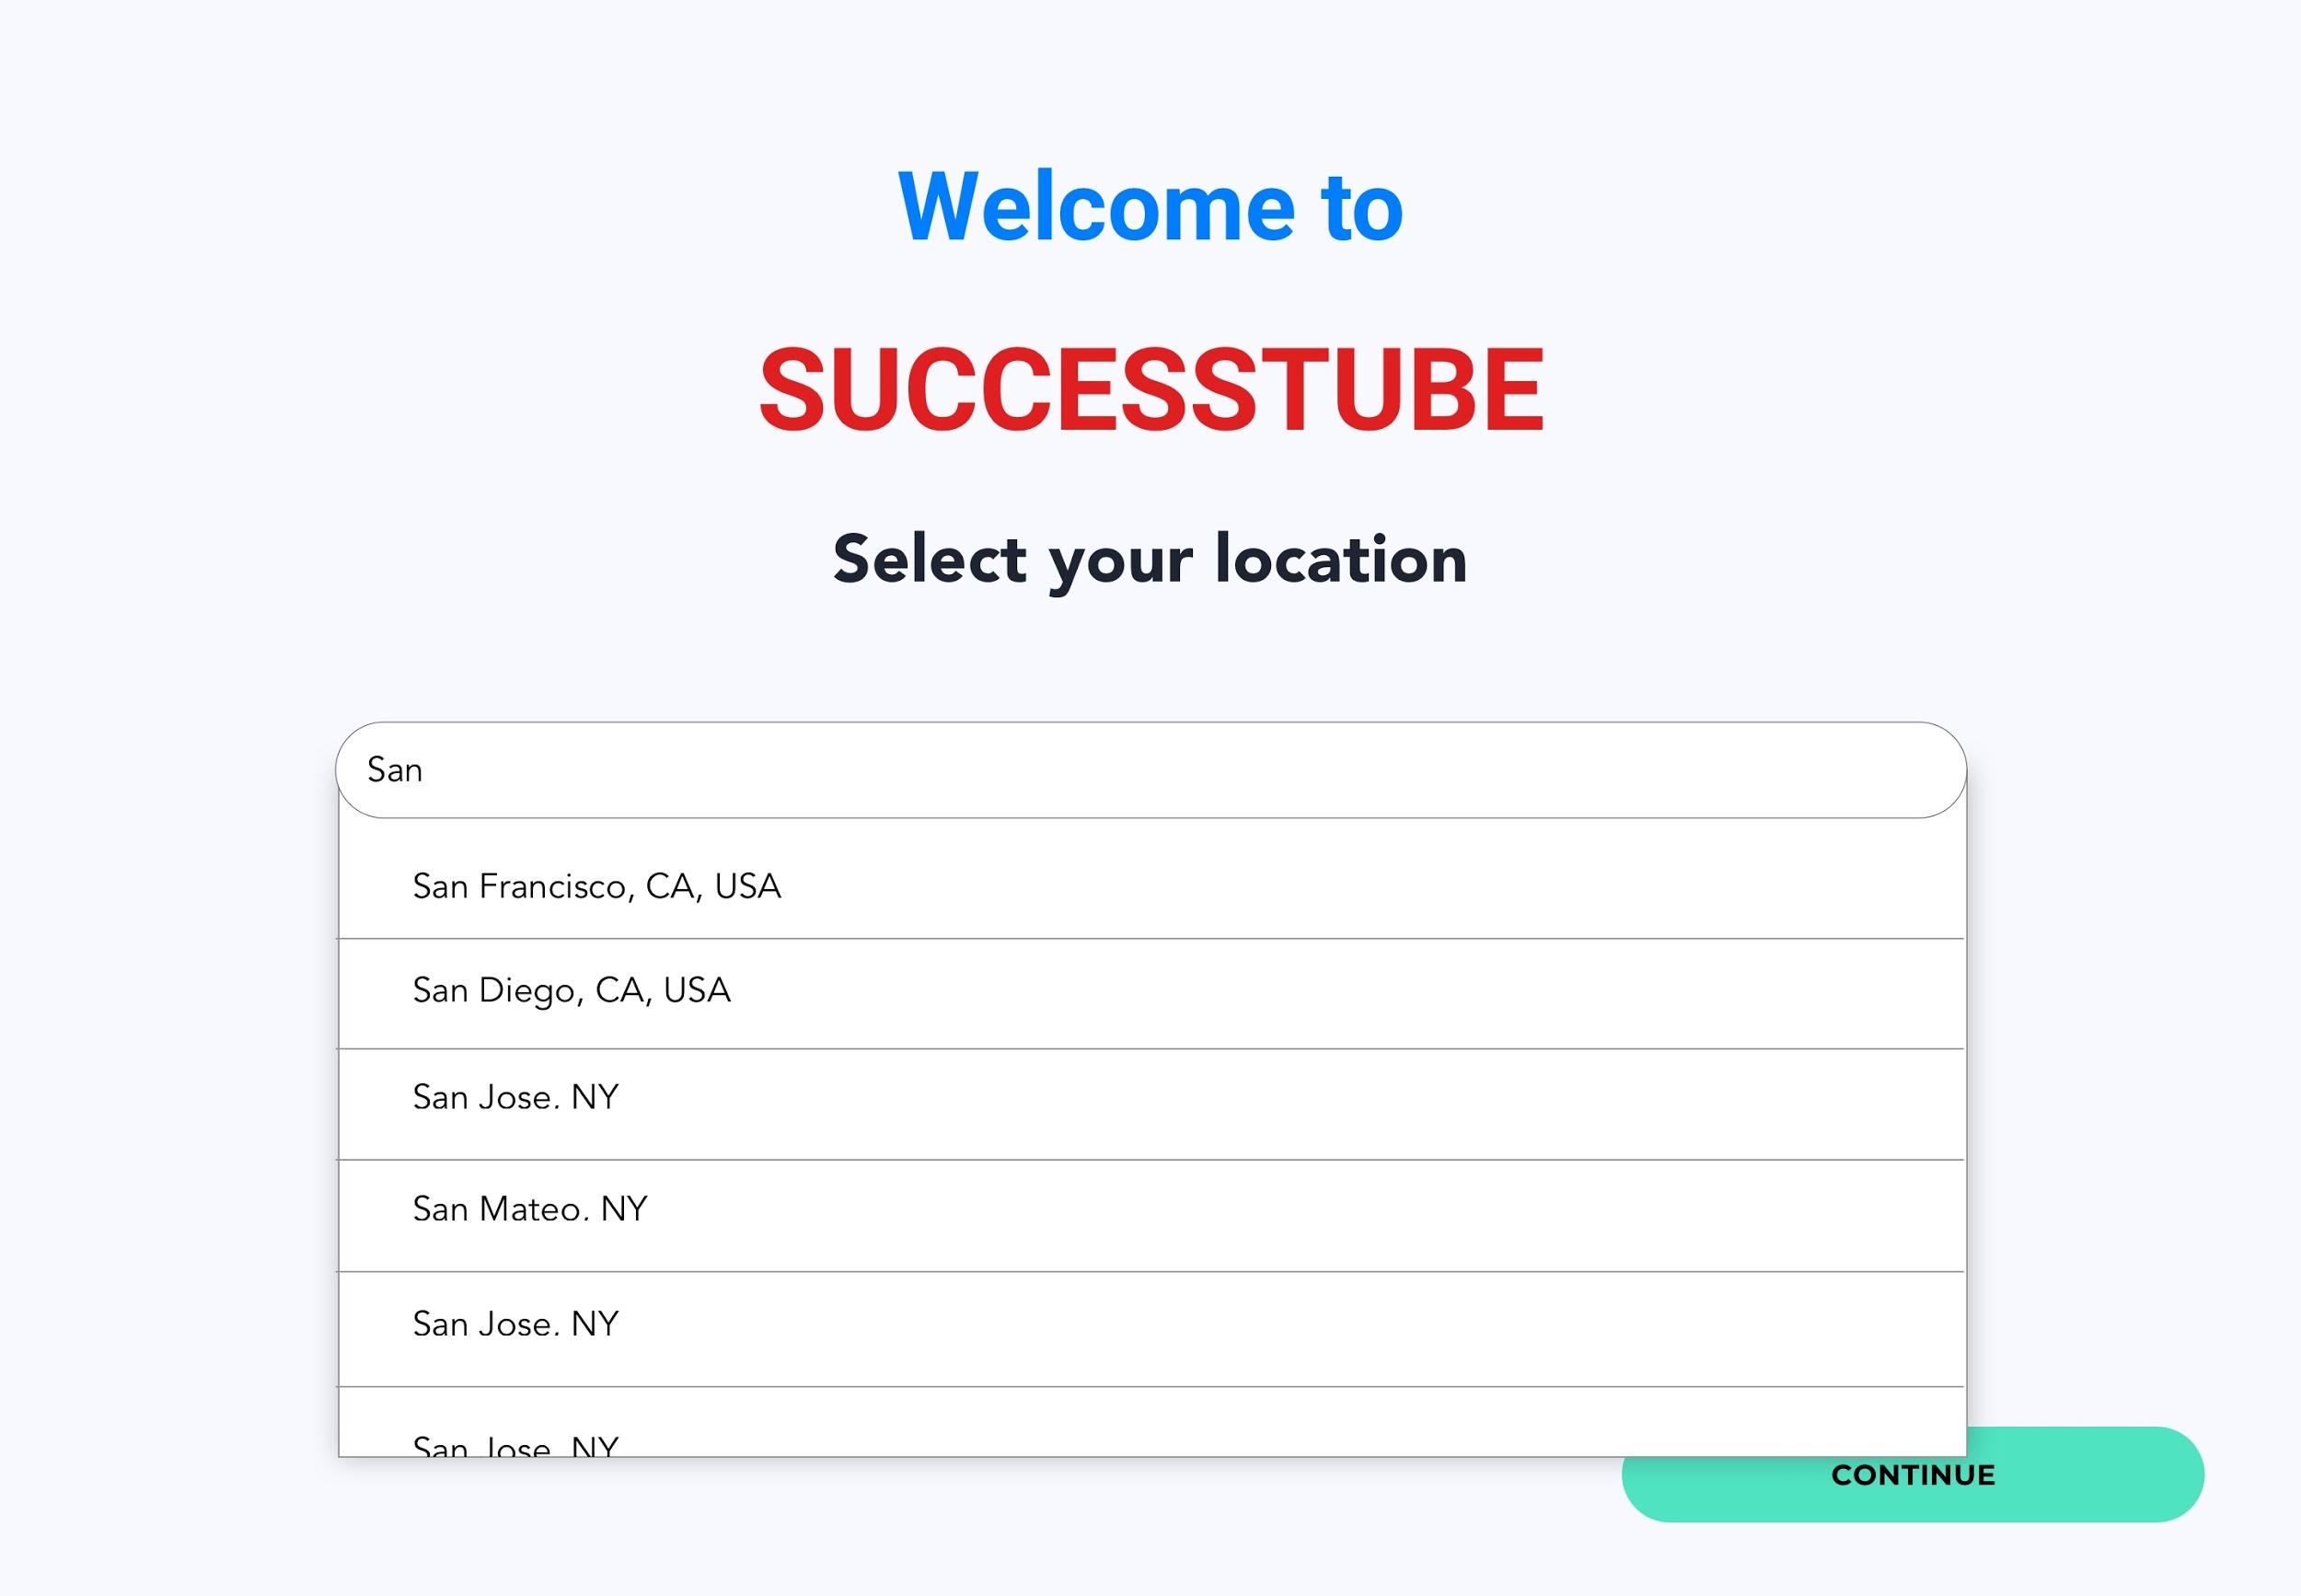
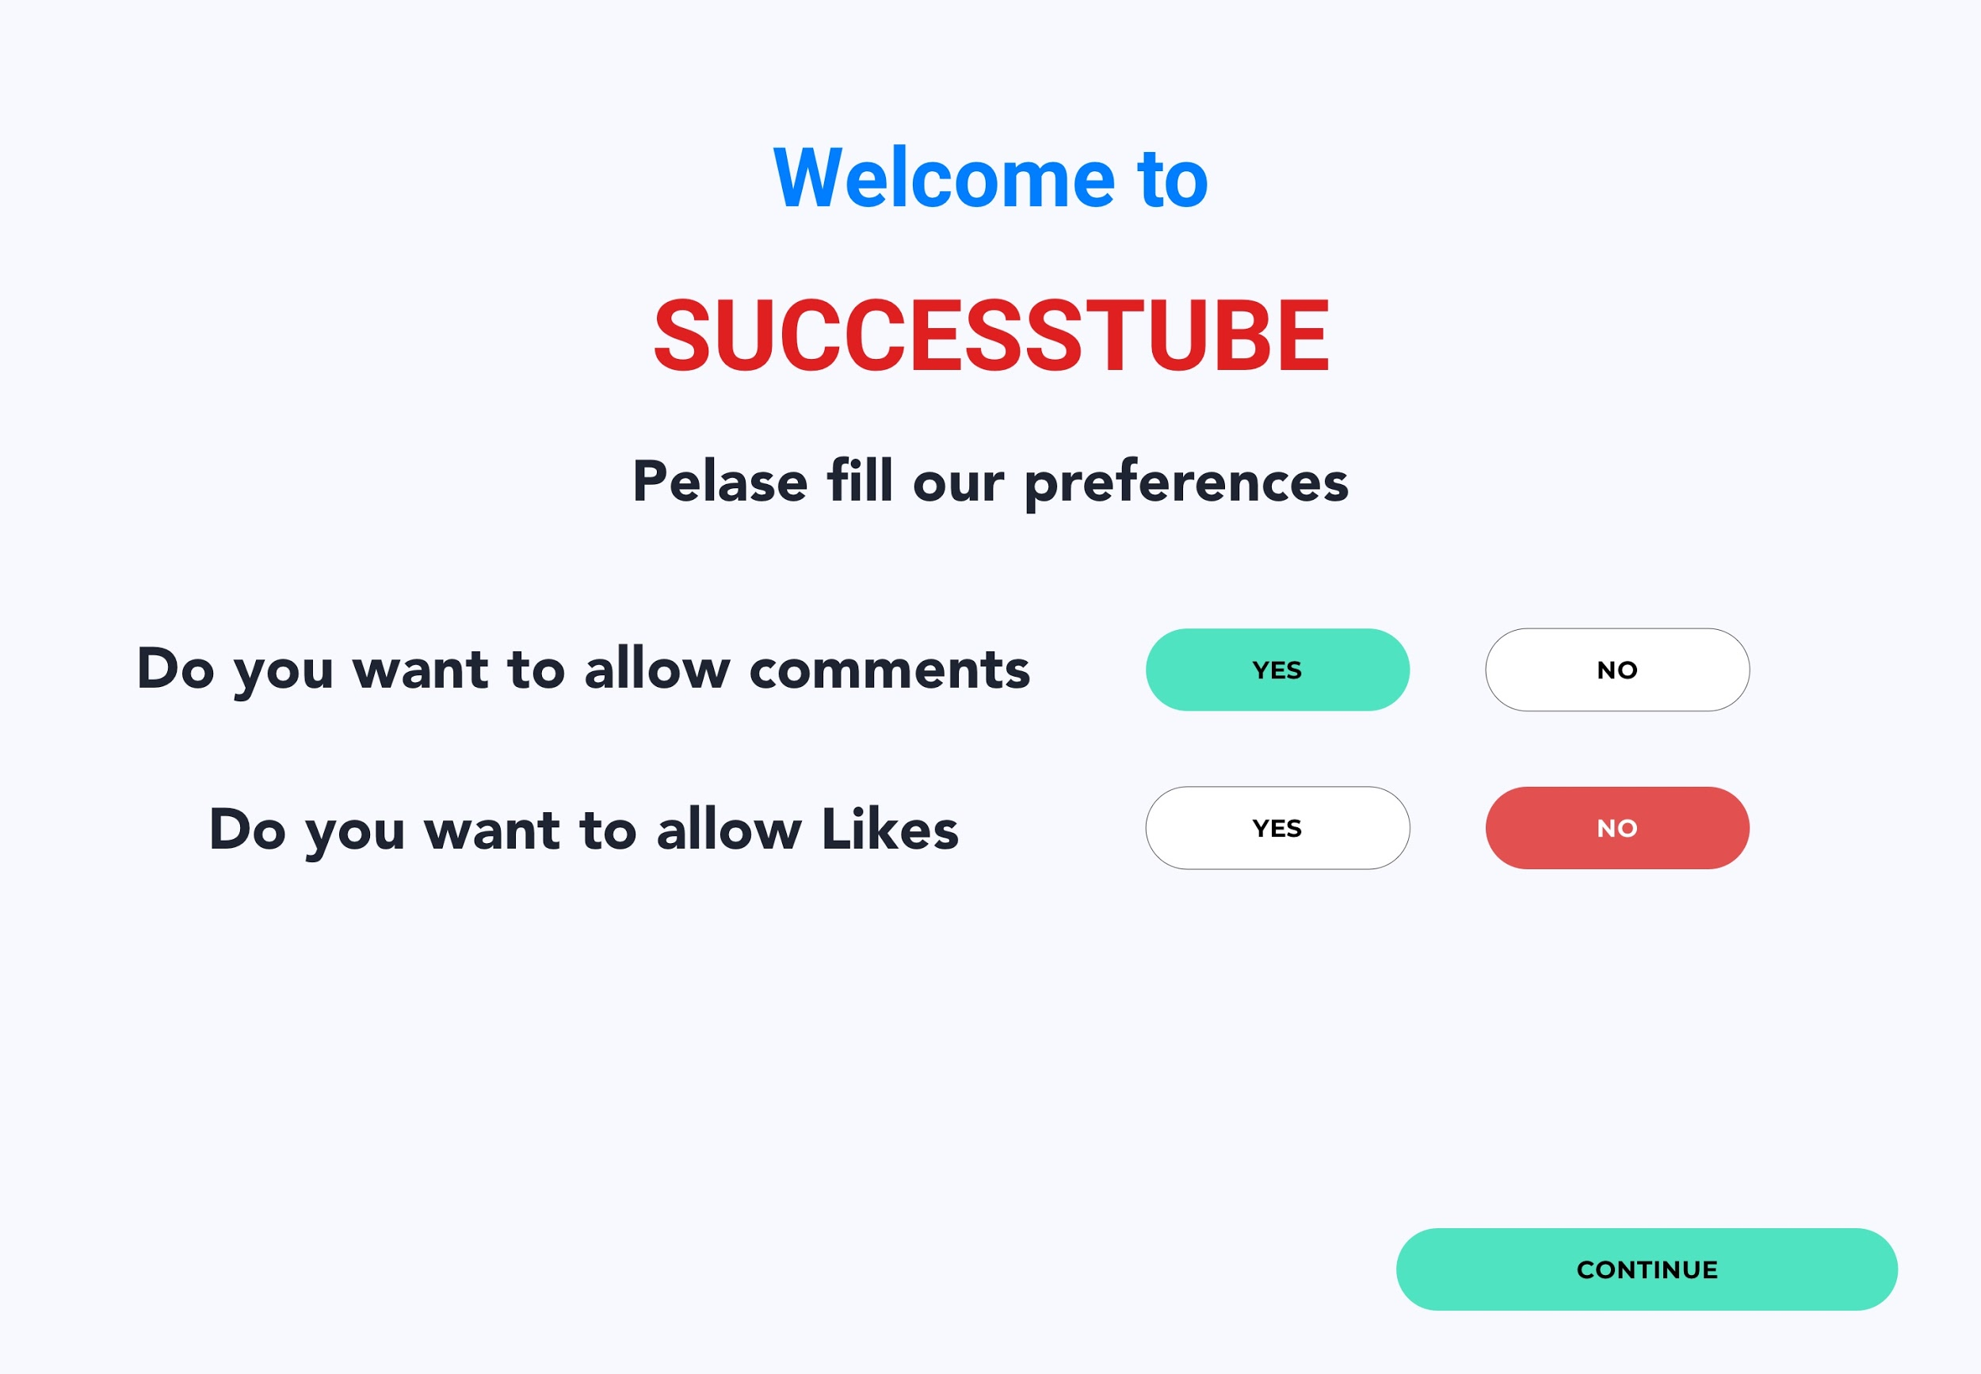
User flows
USER INTERESTS
USER LOCATION
USER PREFERENCES

Slide 6
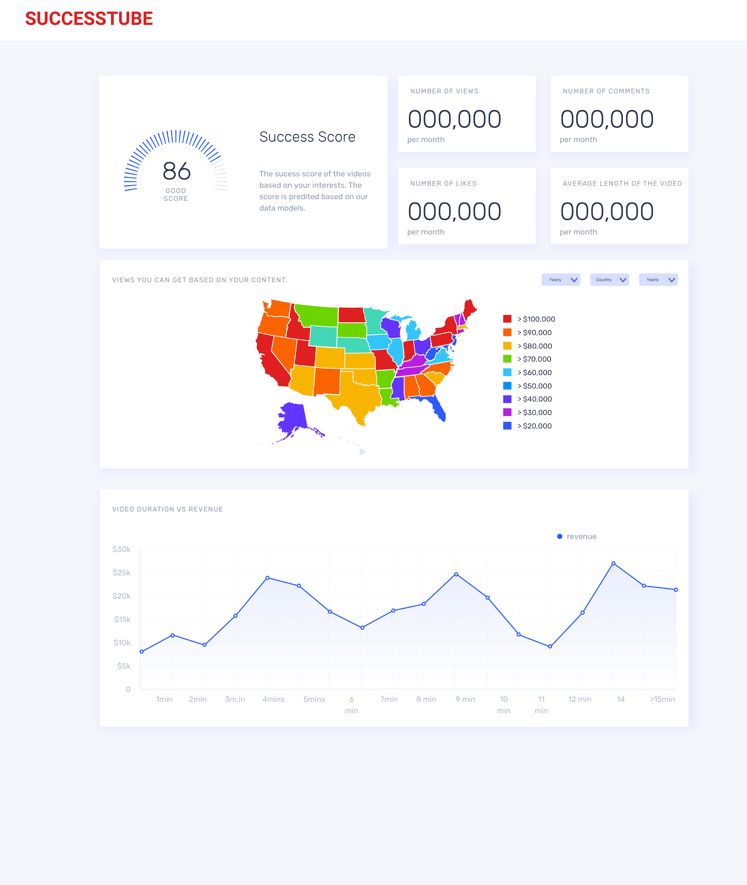
DASHBOARD

